Slide 1

Telerik Test Studio
Web/Desktop Testing
Software Quality Assurance
Telerik Software Academy
http://academy.telerik.com

Slide 2

The Lectors
Iliyan Panchev
Senior QA Engineer@ DevCloud Testing &
Test Studio Quality Assurance Team

Slide 3

Table of Contents
Introduction to Telerik Test Studio
Product Features
Working With Projects
Test Organization
Recording Tests
Test Execution
Test Results
Web Application Tests
Data Driven Tests

Slide 4
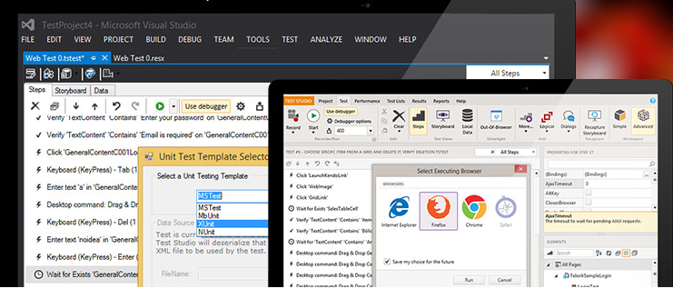
Introduction to Telerik Test Studio

Slide 5
Telerik Test Studio
Telerik Test Studio is an automated testing tool
Offers an intuitive, code/(less) and productive way to test Web or WPF desktop applications
Extends beyond Functional Testing
Manual, Load, Performance, Exploratory testing capabilities
Test Scheduling and Remote Execution
Simultaneous run on multiple environments

Slide 6
Telerik Test Studio (2)
Test recording is performed extremely easy
In the same manner as an end user would accomplish these same tasks
Web test recording is performed directly in the browser
Multi-browser recording:
Internet Explorer recorder
JS recorder for Chrome, Firefox, Safari
Building own Element Repository for easy support and reuse of elements

Slide 7
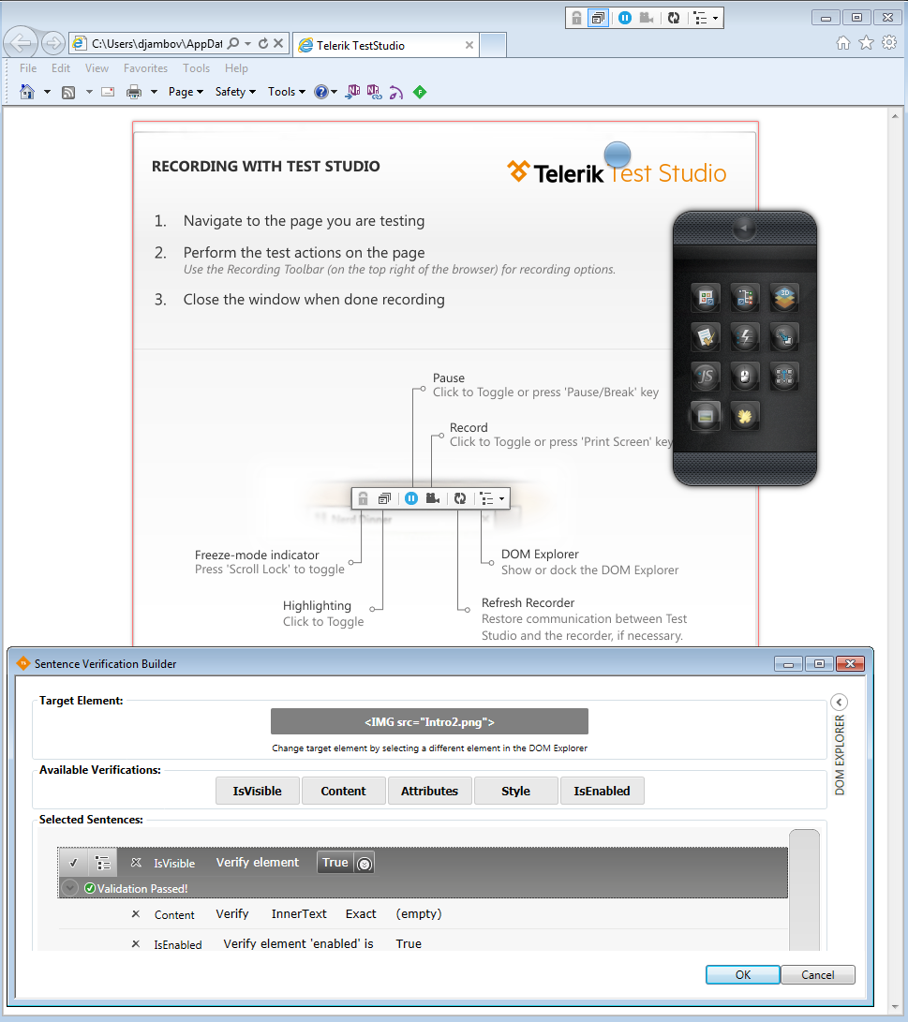
Telerik Test Studio (3)
Navigation, text input, clicking links, drag-and-drop operations, mouse hovering, dialog handling, scrolling, key presses are all automatically recorded as test steps
Smart point-and-click wizards visually highlight elements and automatically generate "verifications" as steps

Slide 8
Test Studio Versions
Test Studio can be used in two IDEs:
Test Studio standalone
Better for non-technical QA professionals with limited programming experience
Provides Full Feature set
Visual Studio plugin
For developers and more technical professionals who prefer VS IDE and need more code usage
Limited Feature set (NO manual, performance, load, scheduling, test lists and results)

Slide 9

Test Studio Features
Test Studio features include:
Multi-browser Recording and Playback
Rich highlighting surface during recording
DOM Explorer (Visual tree)
Element menu for rich on the spot recordings
Quick tasks for common verifications
Data Driven testing
Enhanced Silverlight, Ajax, WPF,
HTML5, Kendo UI support

Slide 10
Test Studio Features (2)
Automatic Synchronization steps
WaitForExists, WaitForVisible, etc.
Use a mix of Coded and Non Coded Steps
Reusing common tests with Test As Steps
Test Lists Management that supports ordering
Results Management using a results calendar
Test Reports
Command line execution support
ArtOfTestRunner.exe command line runner
Telerik.TestStudio.CommandLineClient.exe

Slide 11
Test Studio Features (3)
Integration with other testing related tools
Source Control integration (TFS)
Build Servers integration (TFS, CruiseControl, TeamCity, Jenkins)
User Stories/Acceptance Criteria linking (Telerik TeamPulse)
Bug Tracking (Telerik TeamPulse, TFS, JIRA)
Automation tests linking with Test Management (Microsoft Test Manager)
Tests, Test Lists and Results synchronization (Quality Center)

Slide 12
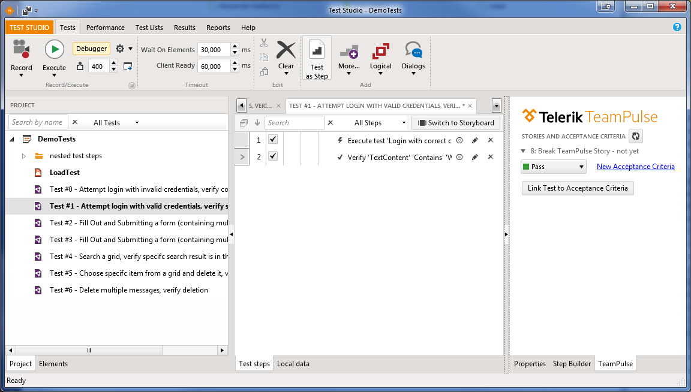
Test Studio Tabs and Panes Tour
Quick Demo

Slide 13
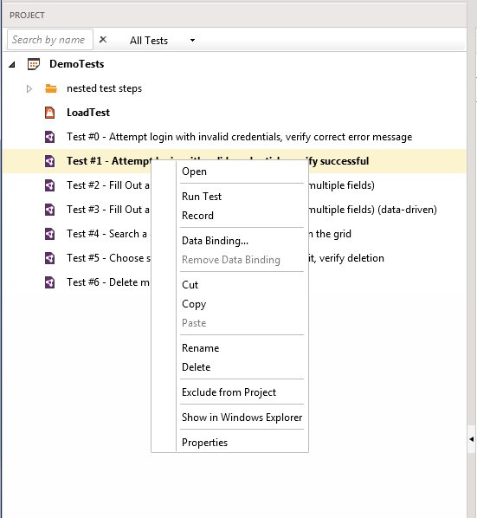
Working With Projects

Slide 14
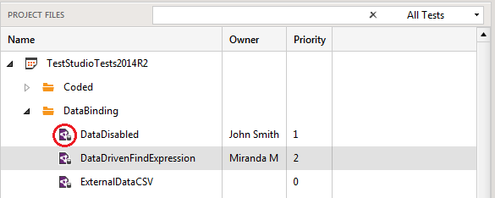
Project Files Pane
The Project Files Pane provides visual cues about state and configuration of the project:
Folders and tests, Properties, Data Management, Scheduling configuration, TFS connection, TeamPulse integration, Bug Tracking and General Project Settings
Example: databound
tests display the
database icon:

Slide 15
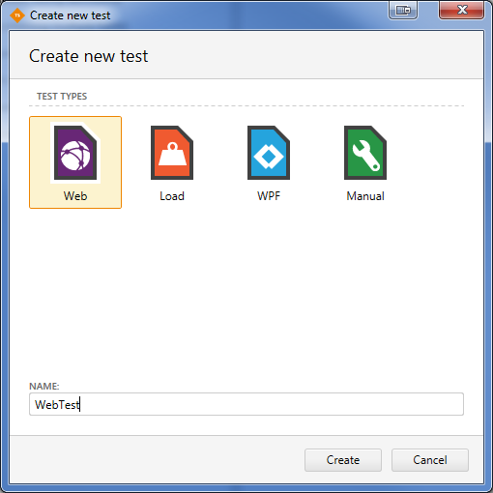
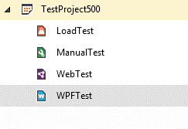
Web vs. WPF Tests
Test Studio provides convenient organization of Web, Load, WPF, and Manual tests in a single project

Slide 16
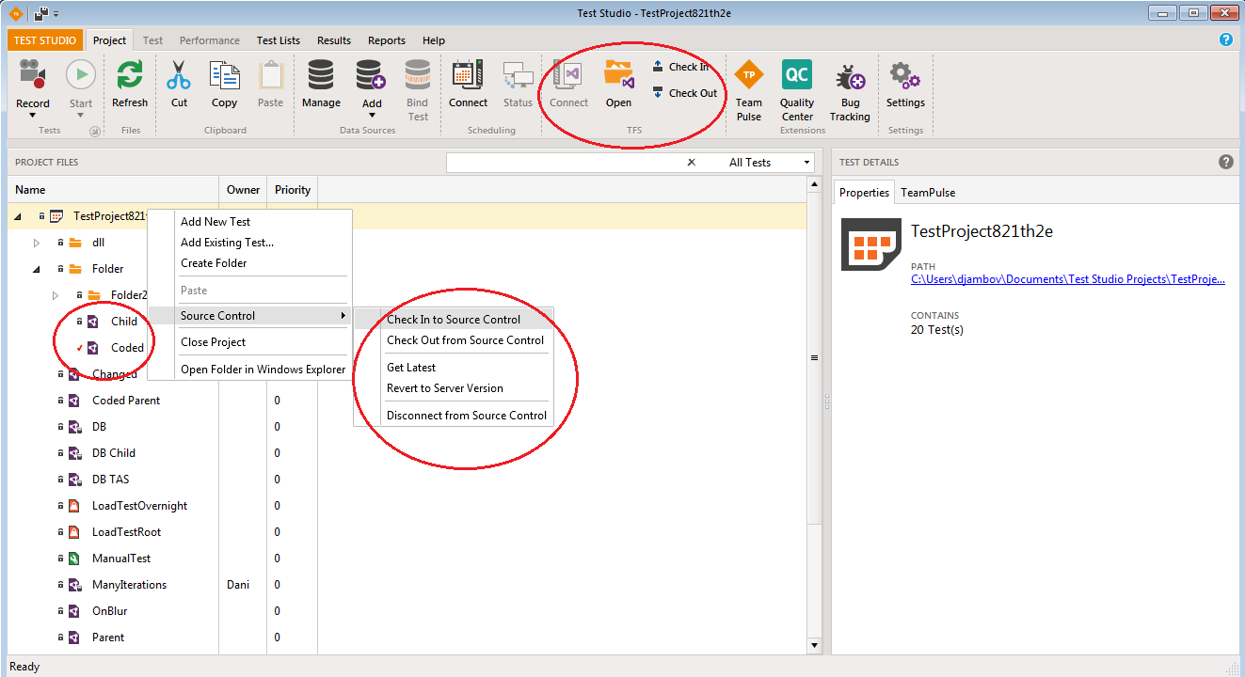
TFS Integration
Test Studio can be integrated to Team Foundation Server

Slide 17
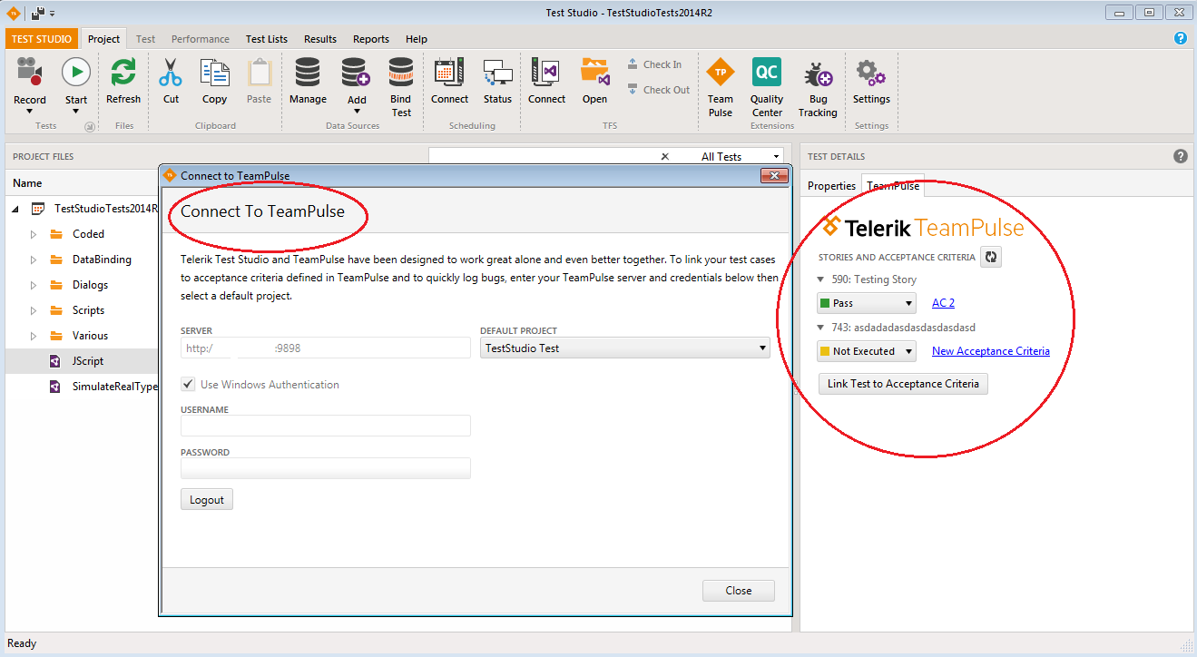
TeamPulse Integration
Test Studio provides
Enables linking between user stories and acceptance test criteria in TeamPulse to functional tests within Telerik Test Studio

Slide 18
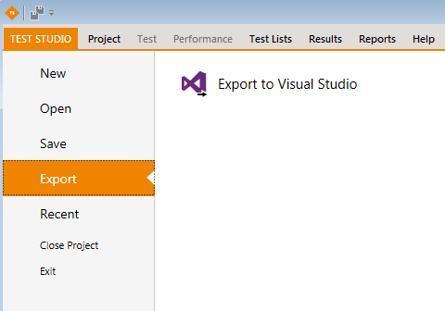
Export Project to Visual Studio
Test Studio projects can be exported in a form that can be consumed by developers using Visual Studio
The Export to Visual Studio Ribbon Bar menu item creates a Visual Studio 2010, 2012 or 2013 project
Available with or without TFS

Slide 19
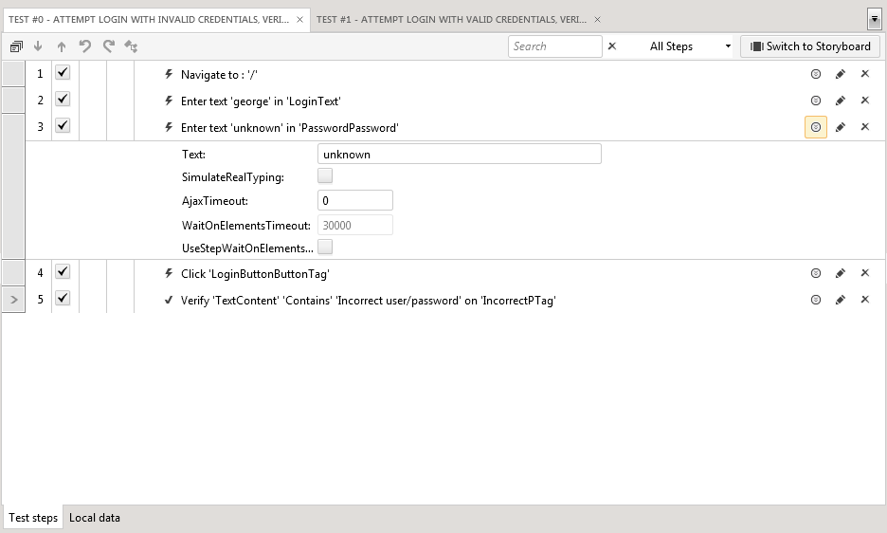
Working With Tests

Slide 20
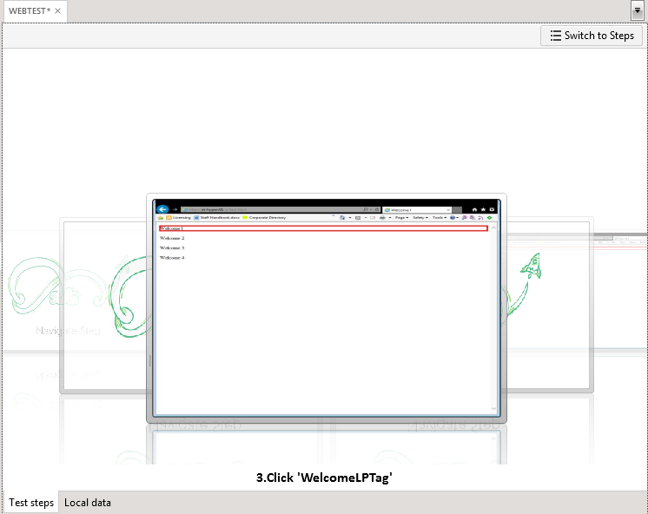
Working with Tests
Test Tabs
Test Steps – Properties, Inline Editor
Re-use tests – add Test As Step
Many steps to be added manually – misc, logical, dialogs
Step debug options
Storyboard

Slide 21
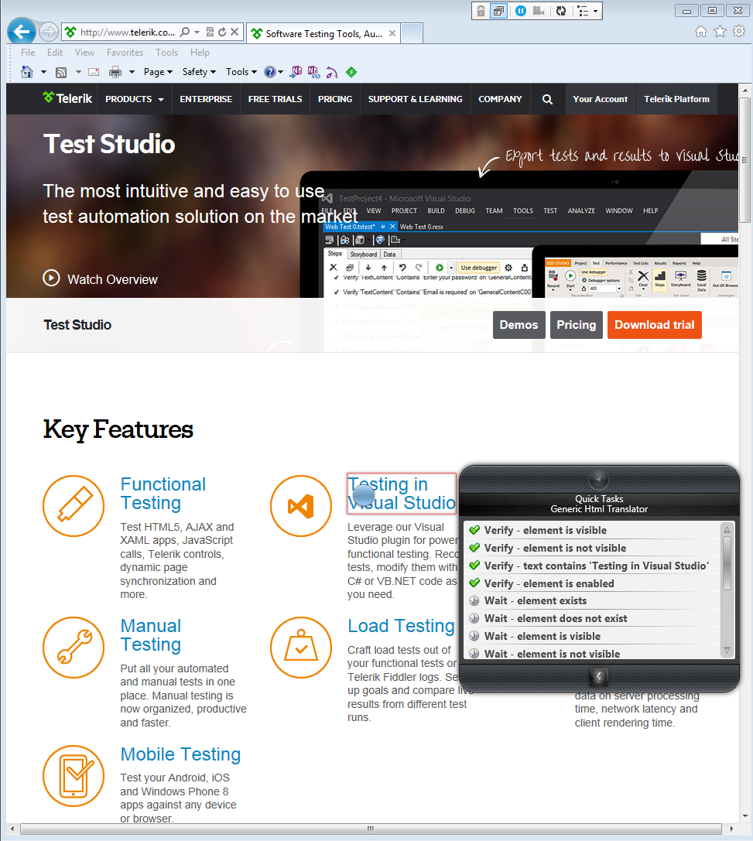
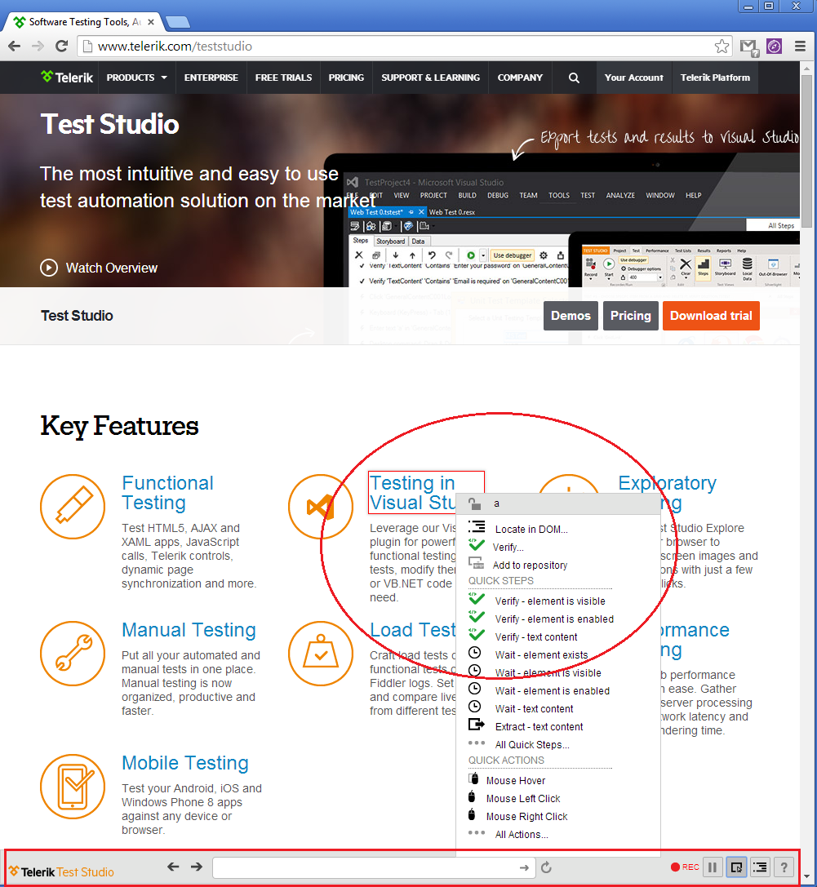
Recording Web Tests
JS Recorder
IE Recording Surface

Slide 22
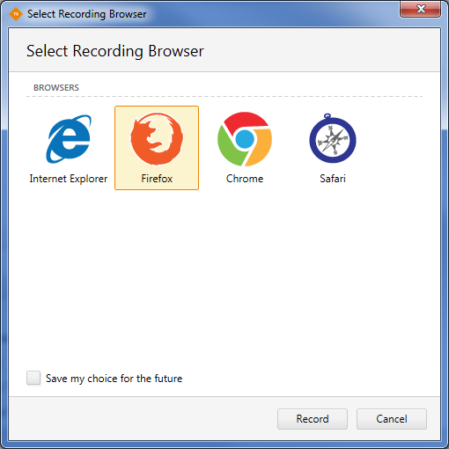
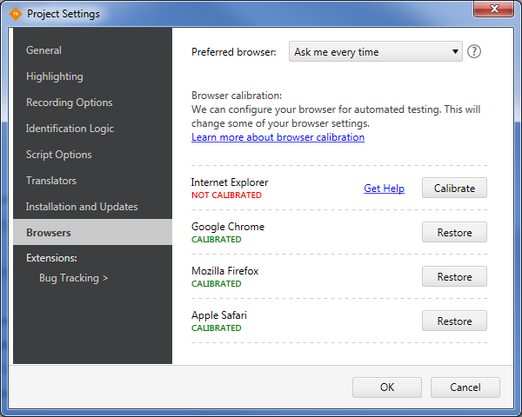
Recording
Recording a webtest in IE, Firefox, Chrome, Safari
Choose the default recording browser
Browser Calibration

Slide 23
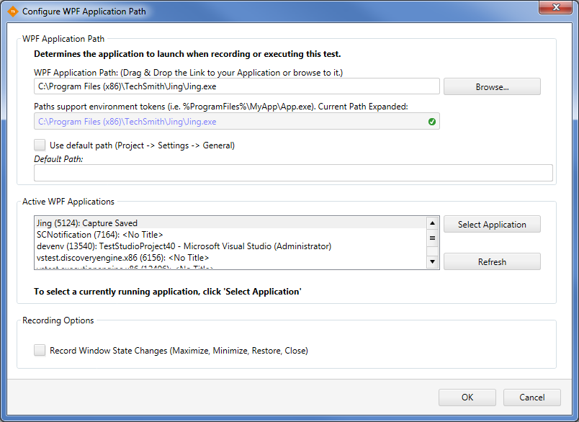
Recording (2)
Recording a WPF test
Configure the application under test

Slide 24
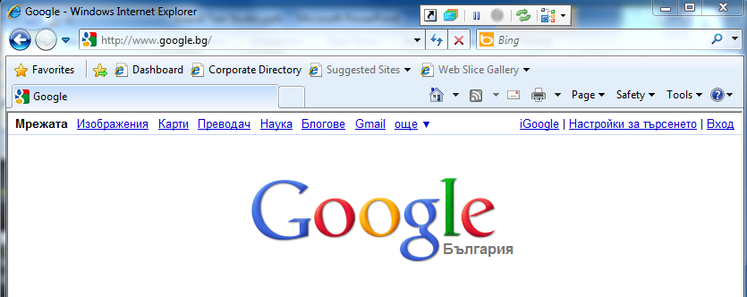
Recording In IE
The Recording Surface Browser provides the ability to record all your actions against a web page
Allows identifying specific elements in the page and handling many common dialogs that might pop up

Slide 25
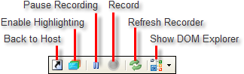
Recording Surface Toolbar
The Recording Surface toolbar controls your interaction with the browser page
Provides the following options:
Lock the UI
Enable Highlighting
Pause Recording
Record
Refresh Recorder
Show DOM Explorer
Pause Recording
Record
Enable Highlighting
Refresh Recorder
Lock UI
Show Dom Explorer

Slide 26
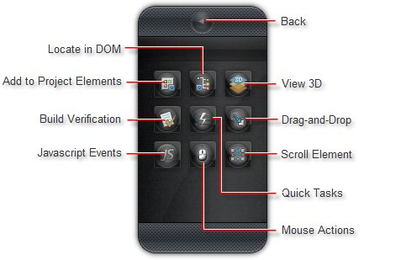
Elements Menu
The Elements Menu provides quick access to relevant functions right in the page you are testing

Slide 27

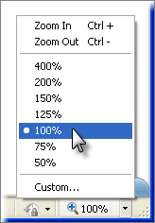
Browser Resolution
Browser Resolution
If the highlight appears offset from the element it should be surrounding, make sure that your browser zoom level is set to 100%
In the screenshot below, the zoom level is 90%

Slide 28
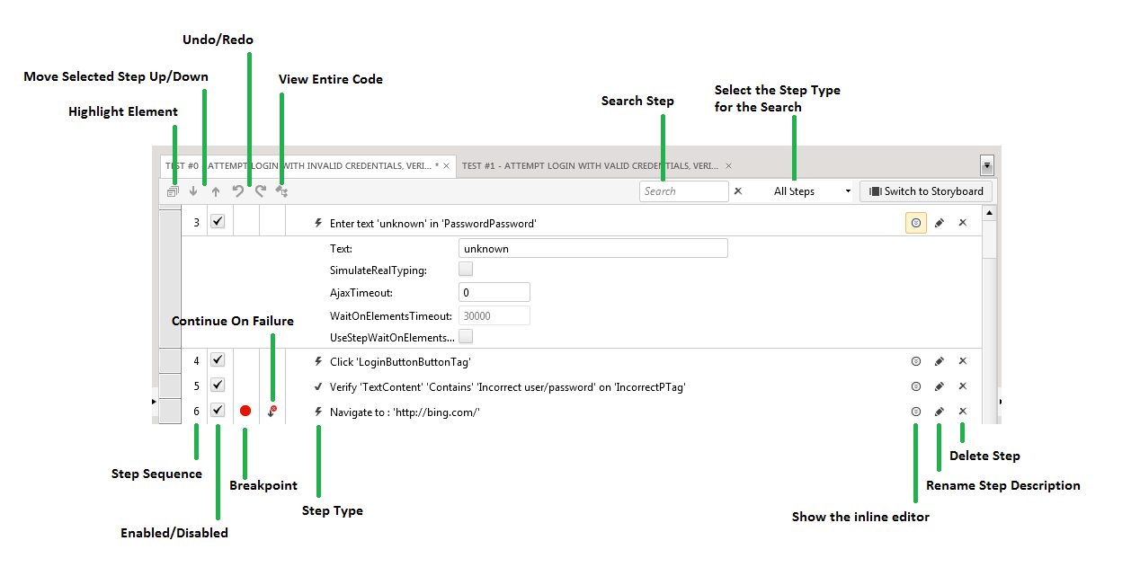
Test Steps
The Steps Pane allows working with individual steps in the test, the step's elements and any code for the test

Slide 29
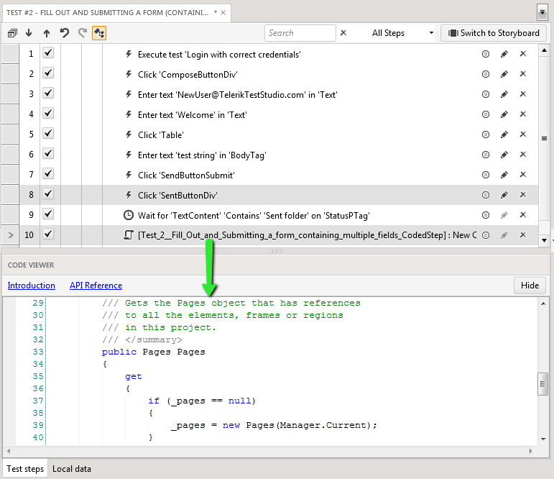
Adding Test Steps Manually
There are some steps that have to be added specifically
Test as Step lets you run another test as a single step
Script Step adds a coded step to the test and opens the code editor

Slide 30
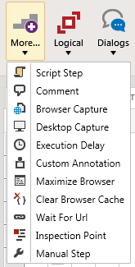
Additional Steps Options
The More... button provides additional steps to add to your test

Slide 31
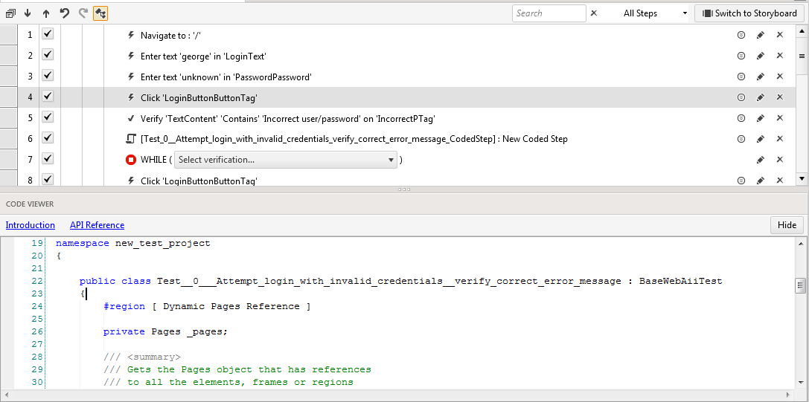
Script Steps
Add manually a script step
Convert existing step to code
Cannot be converted back to regular step
Either C# or Visual Basic can be used
"View Entire Code" Option
API Reference

Slide 32
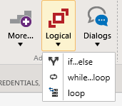
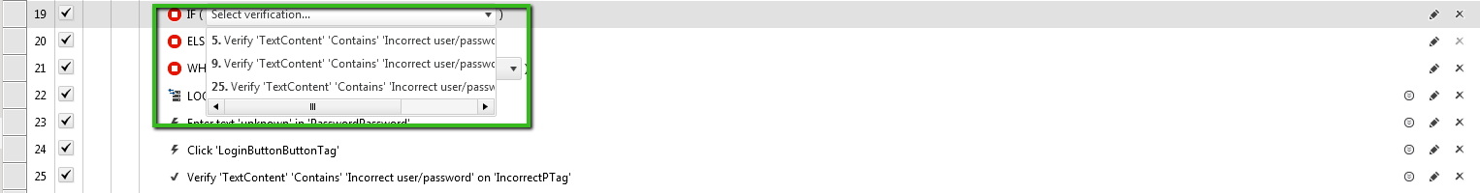
Logical Steps
The flow control in Test Studio can be implemented through logical steps
If…else
While…loop
Loop

Slide 33
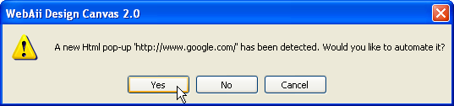
HTML Popups
HTML popups are detected by Test Studio automatically
When an HTML popup is about to appear, Test Studio allows you to automate the popup

Slide 34
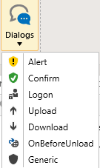
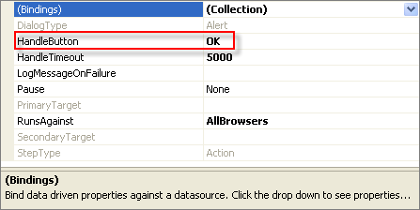
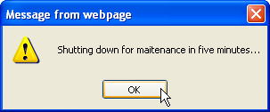
Win32 Dialogs
You can respond to a number of common Win32 dialogs using the Recording Surface "Dialogs" drop down list

Slide 35
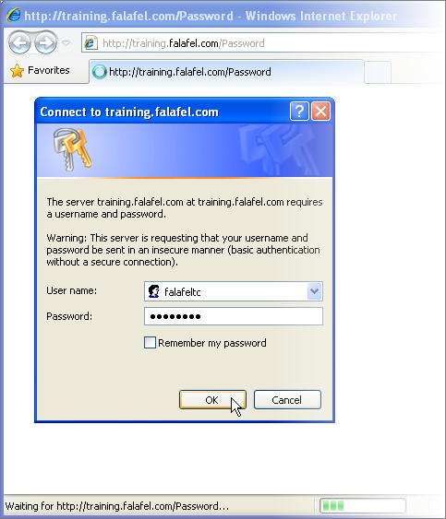
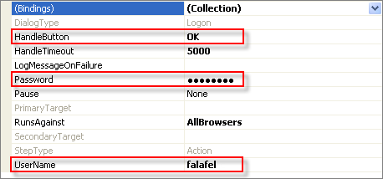
Logon
Some web pages may require a user name and password to gain access
The logon handler fills in the user name and password and then clicks the OK or Cancel button to close the dialog

Slide 36
Drag and Drop
Drag and drop of any element in a web page can be automated
I.e. simple HTML elements, RadControls for ASP.NET AJAX and Silverlight elements
There are two ways to automate a drag and drop operation
Dragging elements directly with the mouse in the Recording Surface
Using the Elements Menu Drag and Drop option

Slide 37

Translators
Translators are extensions that open up an element to work with Test Studio
The translator describes the actions of an element that can be automated and verifications that can be performed
Test Studio ships with basic translators for HTML and Silverlight, and translators built specifically for AJAX and Silverlight RadControls

Slide 38


Verification
Verifying Elements' State

Slide 39
Verifications
Test Studio verifications allow detecting if elements are in a particular state (e.g. visible, exist)
Also that attributes and properties compare with specific values
Test Studio can verify:
Content, attributes, styles, visibility, drop-down list selections, checkboxes, radio buttons, tables and Silverlight property values

Slide 40
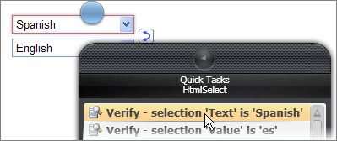
Verification Sentences
Test Studio implements verification through "sentences" that compare a portion of an element to a value
E.g., "textbox content is equal to 'order 8599'"
"image path contains 'http://www.falafel.com'"

Slide 41
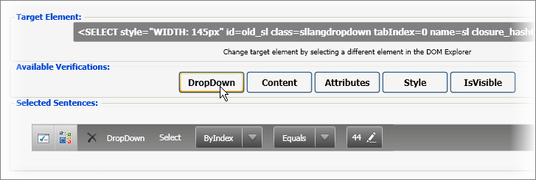
Sentence Verification Builder
The Sentence Verification Builder
Allows interactive building of verification rules and validating them against a live web document

Slide 42
Sentence Structure
The structure of the "sentence" changes according to verification type
Here are the general structures for some of the basic verification types used against HTML elements
Verification Type | Structure
Content | Content Type-Compare-Value
Attribute | Attribute Name-Compare-Value
IsVisible | Value
Style | Inline/Computed-Category-Attribute-Compare-Value
DropDown | Attribute Name-Compare-Value

Slide 43
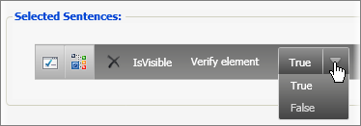
Verification Types
IsVisible
Test Studio determines visibility by following the CSS chain
Analyzing "visibility" and "display" attributes for an element

Slide 44
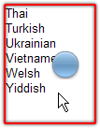
Verification Types (2)
Content verification
Test some portion of element content against a string of characters
Content type
Comparison
Value

Slide 45
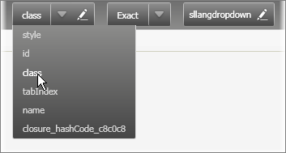
Verification Types (3)
Attribute verification
Allows high flexibility against any attribute in an element
The attribute name drop down lists all the attributes in the element
When an attribute is selected, the Value will automatically populate with appropriate matching text

Slide 46
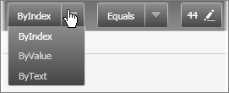
Verification Types (4)
Style verification
Has a relatively complex sentence structure
DropDown verification
The DropDown verification has built-in attribute types "ByIndex", "ByValue" and "ByText"

Slide 47
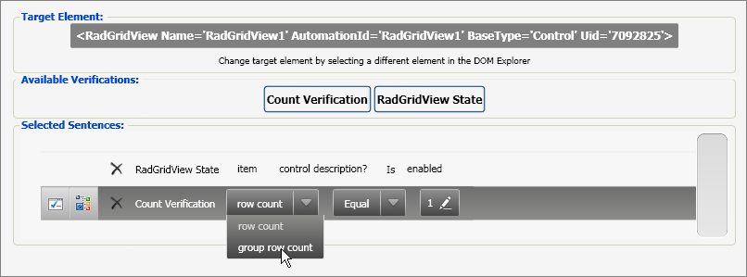
AJAX and Silverlight (5)
Test Studio provide easy testing for AJAX and Silverlight by way of the consistent Sentence Verification Builder interface
Instead of looking at the HTML DOM, we're able to test against Silverlight elements in a XAML (Extended Application Markup Language) document

Slide 48
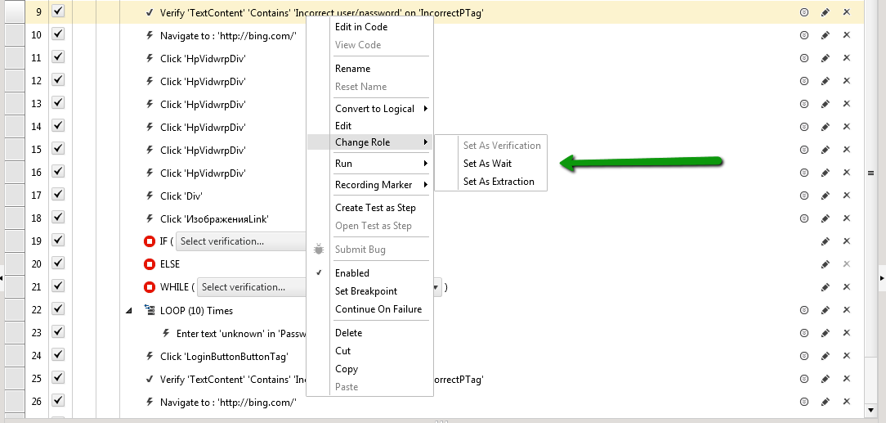
Setting "Wait" Steps
Test Studio allows changing any verification step to a "wait" step
A wait step can be added from the Elements Menu Quick Tasks
Another way is by right-clicking the verification test step and selecting Set as Wait from the context menu

Slide 49
Setting "Wait" Steps (2)
The verification step, when acting as a wait, has a few properties:
CheckInterval
The number of milliseconds between evaluations of the verification
Timeout
The number of milliseconds before the test step will fail when used as a wait

Slide 50
Setting "Wait" Steps (3)
The verification step, when acting as a wait, has a few properties:
WaitOnElements
indicates that the test step should wait WaitOnElementsTimeout milliseconds for step elements to exist before executing the test step
SupportsWait, IsWaitOnly and StepType
Read-only properties that indicate the way this test step can be used

Slide 51
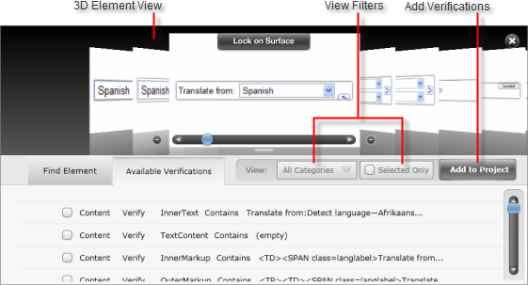
3D Viewer
3D Viewer
The 3D Viewer is an innovation that saves time by handling verifications for multiple elements all at one time

Slide 52
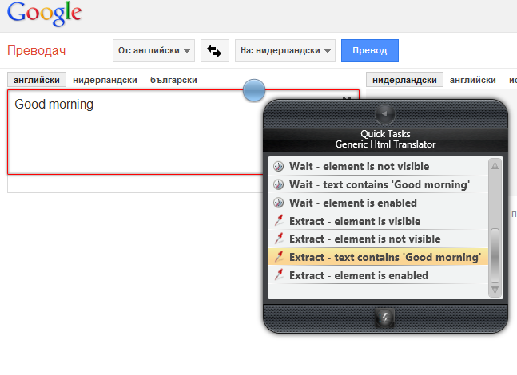
Extraction
Extractions can be added in order to be reused later in the tests
Available form the "Quick Task" menu

Slide 53
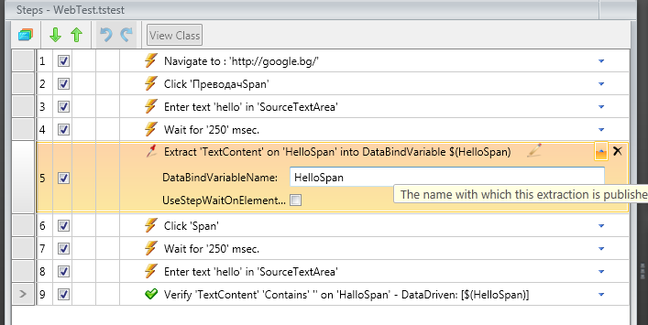
Extraction
Extracted parameter is stored in a variable
We can name our stored variable
We can refer to the variable by its name
Name used to refer to the variable
Name we give to the variable
Referring to the stored variable

Slide 54
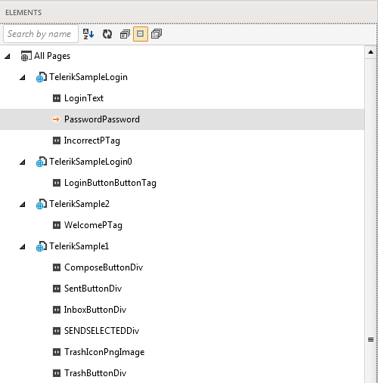
Elements Explorer
The Elements Explorer is similar to the DOM Explorer
it displays a tree of pages and elements
Elements may be used in different tests and test steps
Steps for an element can be added manually via Step Builder

Slide 55
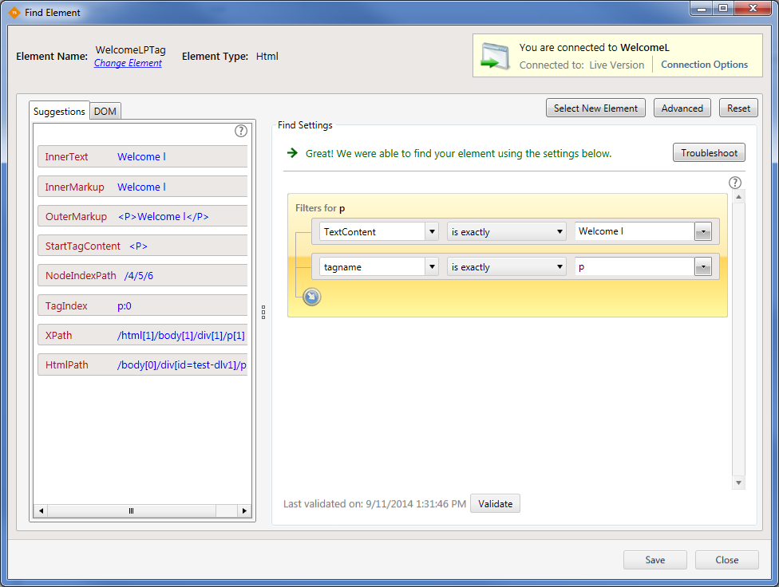
Find Expressions Builder
Find Expressions
the base for all element searches in the DOM, HWnd, or control trees
Support of chained expressions
Identification Logic order
Data binding of find expressions

Slide 56
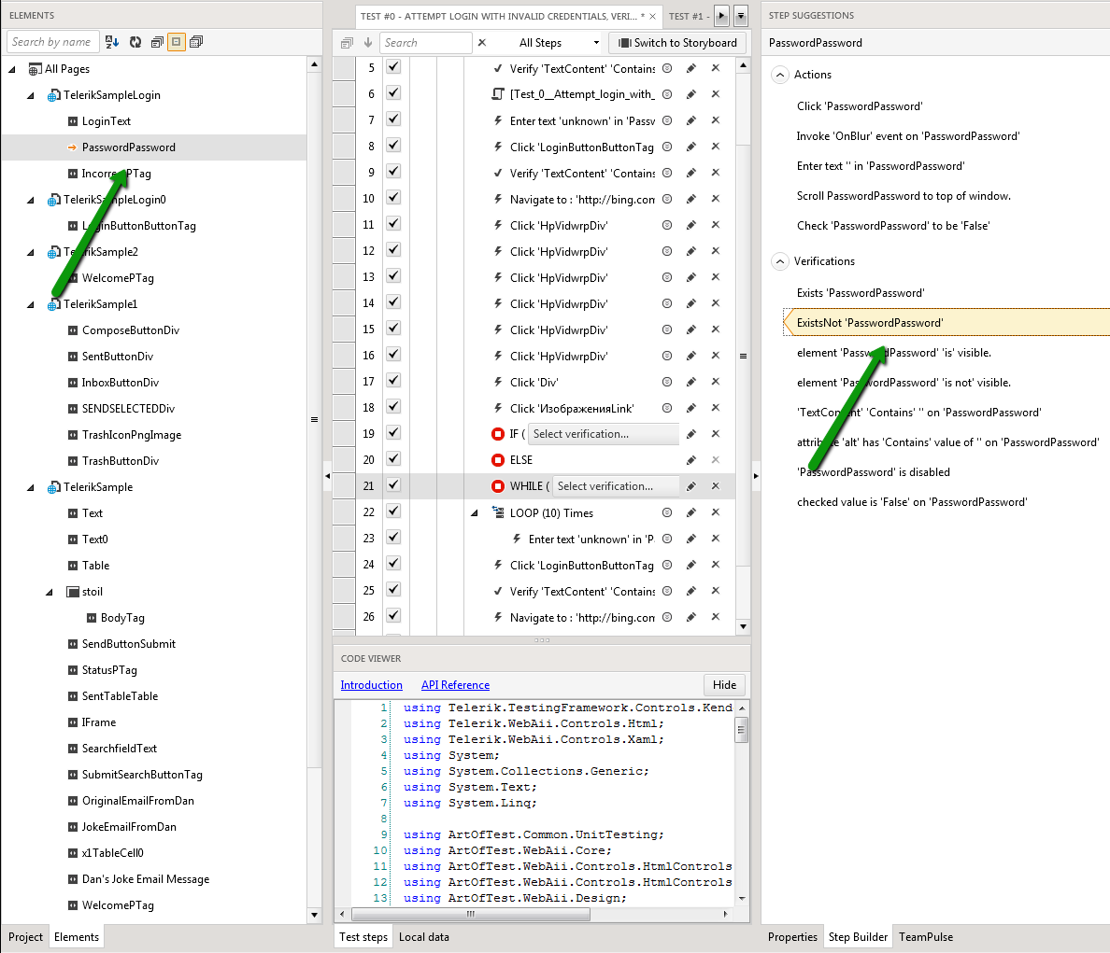
Step Builder
Action and verification steps can be added from the Step Builder to the test
Select an element from Elements Explorer and choose from the available steps in Step Builder

Slide 57
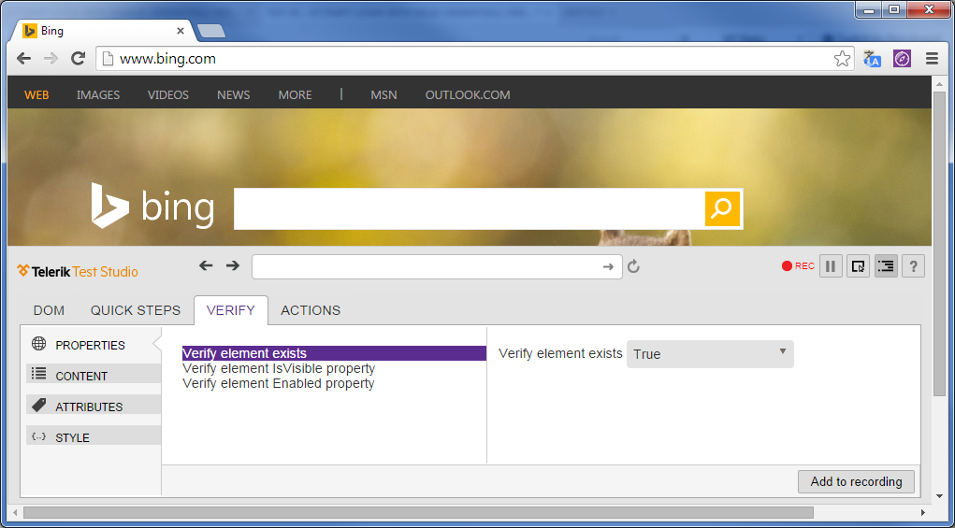
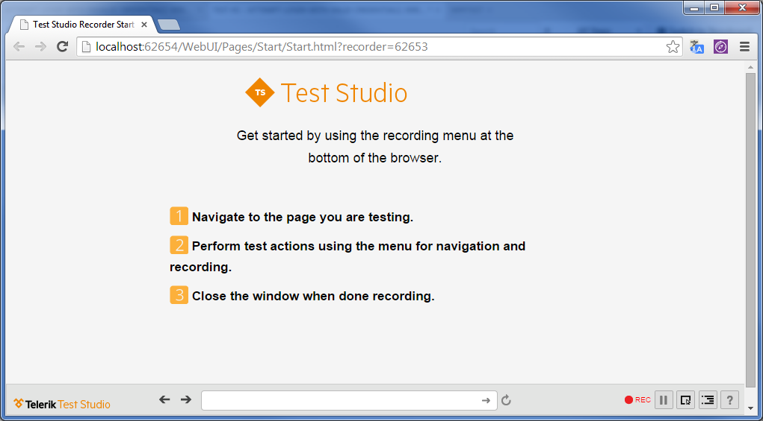
JS Recorder
JS Recorder is for recording in Firefox, Chrome and Safari
It has almost all features of IE Recorder

Slide 58
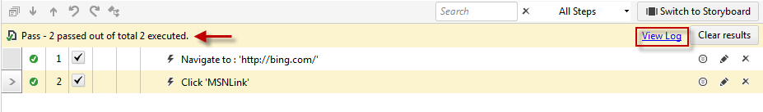

Quick Execute
Executes only one test at a time
Mostly used for debugging during test recording
Execution result and log
Annotations during quick execute

Slide 59




Visual Debugger
Debugger options on quick execute:
Once the test fails, according to the debugger options, a Debug tool appears

Slide 60
Visual Debugger (2)
Once the test pauses, the following Debug Options are available:
Show the DOM Explorer of the currently displayed page
Capture the currently failed state. Save a .zip file containing a snapshot of the DOM, browser image, and test log
Diagnose a failure directly. Only enabled on detected failures
View the current execution log of the test
Easily record any bugs in the target application during debugging

Slide 61

Test Organization
Using Test Lists

Slide 62
Test Lists
Test Lists
Useful for getting the best use of recorded tests by allowing the reuse of tests in more than one configuration
E.g., using a small selection of tests as a "Smoke Test"
Collecting tests that a particular QA engineer is responsible for
Listing all the tests for a category of functionality
Executing bundles of tests in exact time of the day - Scheduling

Slide 63

Static Lists
Static lists
Can be manually built from existing tests and manually set the order that the tests should run
When the Test List executes, each test runs in order, exactly as configured

Slide 64

Dynamic Lists
Dynamic Test Lists automatically select tests from your project at the time of execution
Using rules about properties of the individual tests
Warning – Dynamic Test Lists cannot be ordered
Therefore only independent tests should be grouped dynamically

Slide 65

Editing Test List Settings
Test Studio allows editing the following properties:
Annotation
ASP.NET
Browser
Desktop
Execution
HttpProxy
Log
Navigation
Silverlight

Slide 66

Test Scheduling
Test Studio allows users to Schedule test lists or instantly run them Remotely and send results by mail
Execute across all available Test Runners
Distribute tests across multiple machines

Slide 67


MS Test Manager Integration
Test Studio provides integration with MS Test Manager (MTM 2010/2012)
Linking Telerik Test Studio automation tests (.tstest) with MS Test Case item for automatic execution in MTM environment

Slide 68

Working With Test Results
Analyzing and Sharing Test Results

Slide 69

Test Results Calendar
The calendar view of test results makes it easy to see the tests that passed or failed in a month, week or day

Slide 70

Analyzing Test Results
The TestResults panel allows traversing test execution results, drilling down to the individual test step and back up again to the test list level

Slide 71

Step Failure Details Dialog
The Step Failure Details dialog collects all the information related to a single failed test step, including failure details, screenshots, and a snapshot of the DOM

Slide 72

Exporting Test Results
Test results become truly useful when they are pushed out to the members of your organization
The Export tools allow you to create Word or Excel versions of the entire Test List
With TFS a selected run result can be made accessible to others by pushing out the results to TFS

Slide 73



Web Application Tests
Handling Issues of Web Testing

Slide 74
Web Application Tests
Testing a web application is quite a bit more difficult than testing the same functionality in a Windows Desktop application
Specific issues are encountered:
Timing difficulties
Differences between browsers
New technologies make web browsing a rich, but difficult-to-test, experience

Slide 75


JavaScript
Test Studio can trigger specific JavaScript events as test steps
Use the Elements Menu, JavaScript Events button to invoke and choose from available events

Slide 76

RadControls for ASP.NET AJAX
Testing RadControls for ASP.NET AJAX is s bit different from any other control
Due to the translators provided by Telerik
Test Studio provides set of verifications and Quick Tasks for RadControls

Slide 77

Silverlight
Test Studio is the first scriptless record and playback solution for Silverlight
With Test Studio you can build a single test case that interacts with both HTML and Silverlight elements, even on the same page

Slide 78


Data Driven Tests
Driving Your Tests Using Data Sources

Slide 79

The Built-In Grid
The built-in grid allows you to build simple, ad-hoc, data-driven tests
This functionality is very simple
It is not expected to connect to an external database
Has multiple tables or provide fine tune control over looping or branching

Slide 80
Connecting to External Data
Test Studio allows connecting to a variety of data types
Standard "*.csv" comma delimited files, Excel "*.xls" files , XML files and database tables
The main steps to drive a test with data are:
Add a data source
Bind the data source to a test as a whole
Bind a specific piece or column of data to a property in the test or to a find expression

Slide 81


Data Driven Tests
Demo
Using the built-in grid
Connecting to external data

Slide 82
Telerik Test Studio
?
?
?
?
?
Questions?
?
?
?
?
?
?

Slide 83
Exercises
Make a new test project called Telerik. Record a new test called TelerikAcademy that searches in Bing with keyword Telerik Academy. Verify the text "Telerik Academy" is present among the search results. Click the link provided by the first search results and navigate to the Telerik Academy web page. Verify the presence of the text "Предстоящи курсове". Do not forget to enable the option "Hover over highlighting" in the Recording Surface Toolbar.

Slide 84
Exercises (2)
There is a new requirement for the project from Task 1:
The browser needs to be maximized during execution, if the search field is visible
Add a new coded step at the beginning of the test.
Check with code if the bing search field is visible. If true, Maximize the browser. If false, write in the log message that the field isn’t visible.
Can you do this without code?

Slide 85
Exercises (3)
The test from the already created project is an important regression test that needs to validate if the Bing page is up and running after the scheduled website publish, that happens every day at 11:00 AM.
Fortunately another team has set up a Test Studio scheduling server that you can use, as well.
After the regression run is completed, check the results if everything is passing.
4. The team switches to Scrum. A new TeamPulse project is set up - TestStudio. Connect your project to the server and link your test to an Acceptance Criteria.

Slide 86
Exercises (4)
Record a test that navigates to the Telerik Silverlight demo page http://demos.telerik.com/silverlight/#ComboBox/FirstLook Wait for the page to be loaded, verify the presence of the "Online Book Store" header. Verify the presence of the "Technology" drop-down list. Choose one of the elements of the drop-down list and after that verify that the same value appears as chosen on the drop-down list button. Repeat the last steps with the "category" drop-down list.

Slide 87
Exercises (5)
Try your own tests with some of the rest Silverlight control samples.
Record a test that searches for a set of different animals in Google and verifies the keyword is present among the search results. Use the built-in grid and create a database of keywords (animal names) to be used for searching.

Slide 88
Exercises (6)
Read more about Telerik Test Studio from the Telerik's web site: http://www.telerik.com/automated-testing-tools/support/documentation.aspx
Watch the video tutorials about Telerik Test Studio from here: http://www.telerik.com/automated-testing-tools/support/videos.aspx

